Slide 1
RAG System
Knowledge Assistant
Project by: Soundarya A
Retrieval-Augmented Generation (RAG) Pipeline built with Python, Sentence Transformers, ChromaDB, and LLaMA (Ollama) — delivering accurate, context-grounded answers from trusted documents.

Slide 2
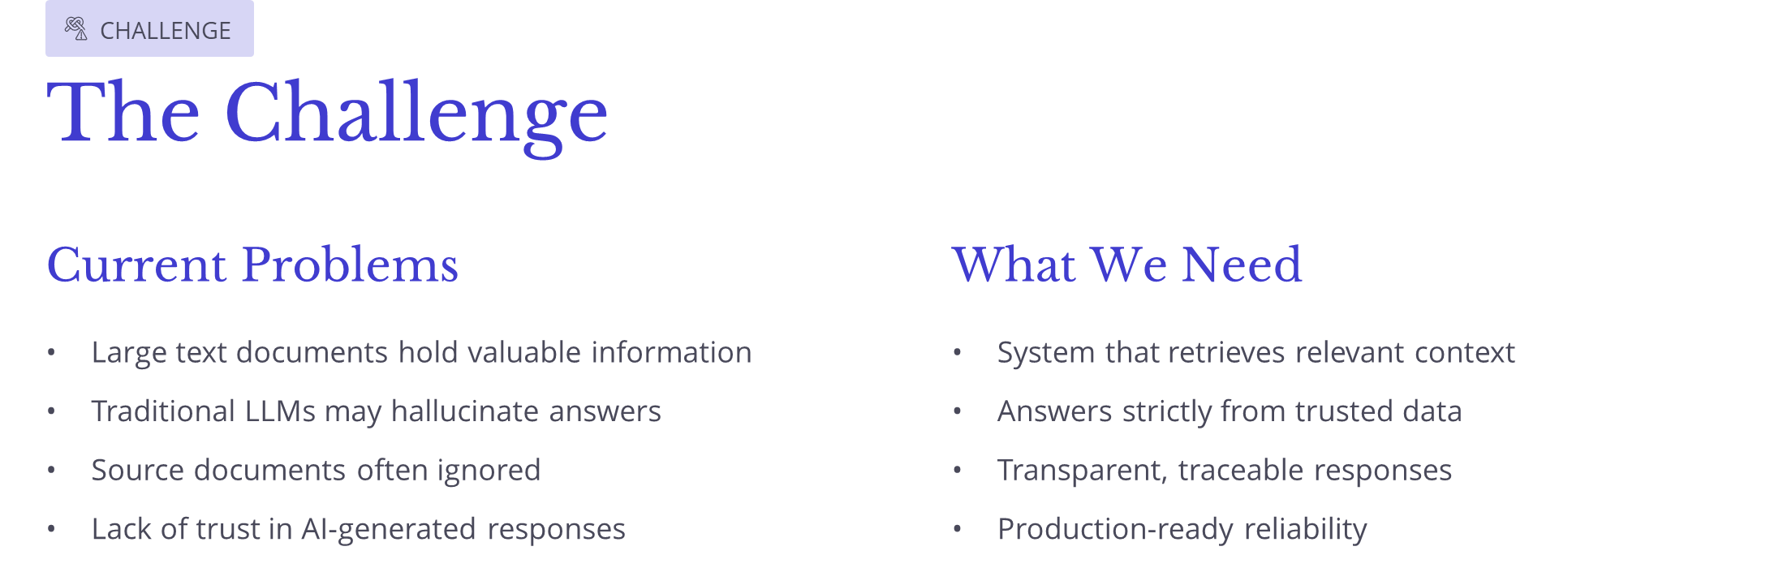

Slide 3
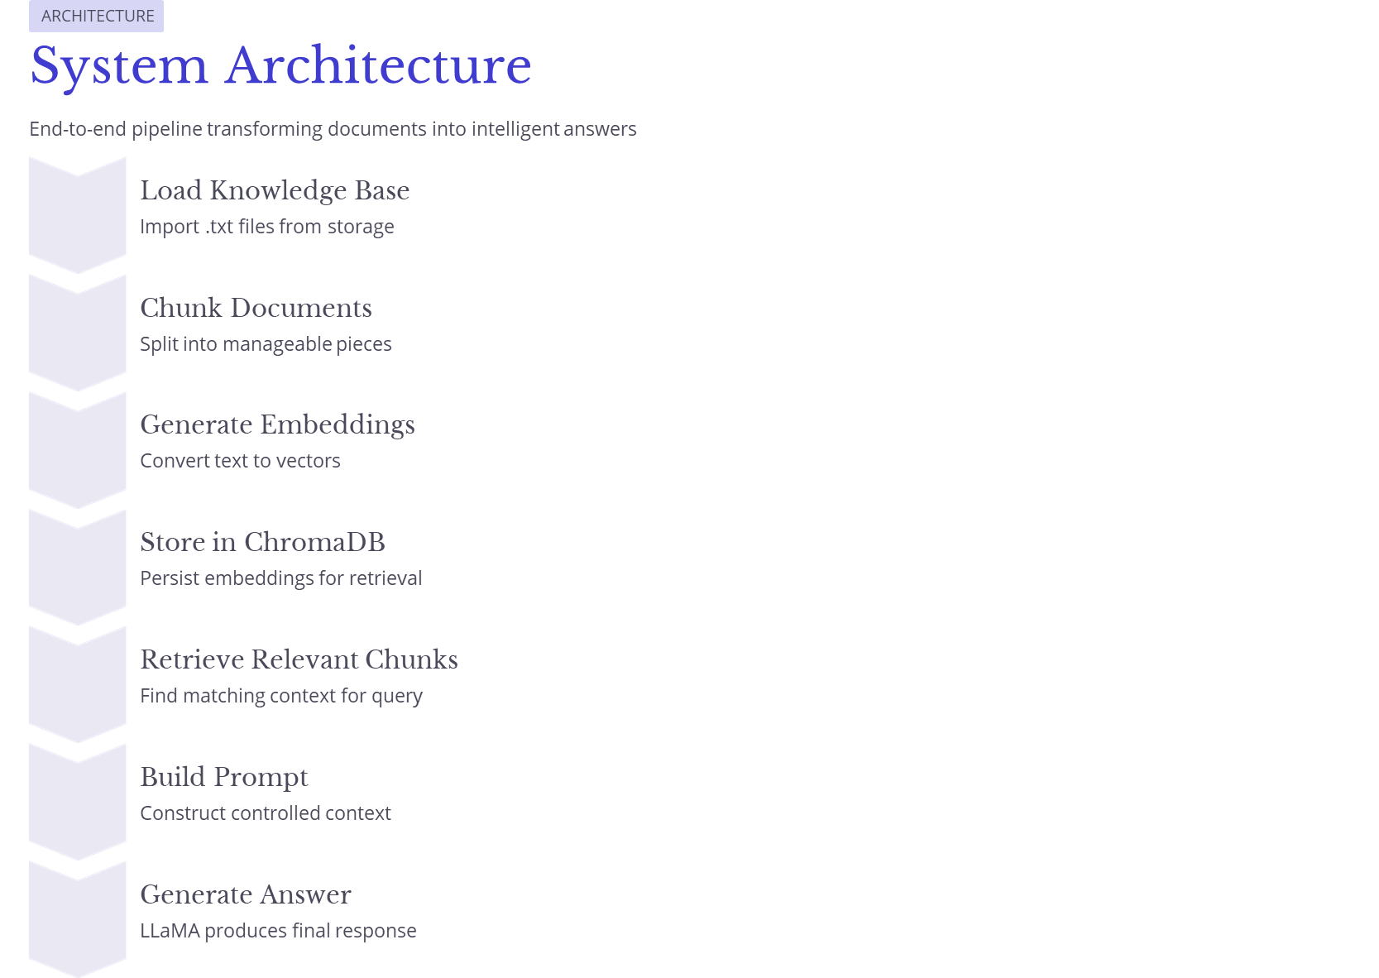

Slide 4
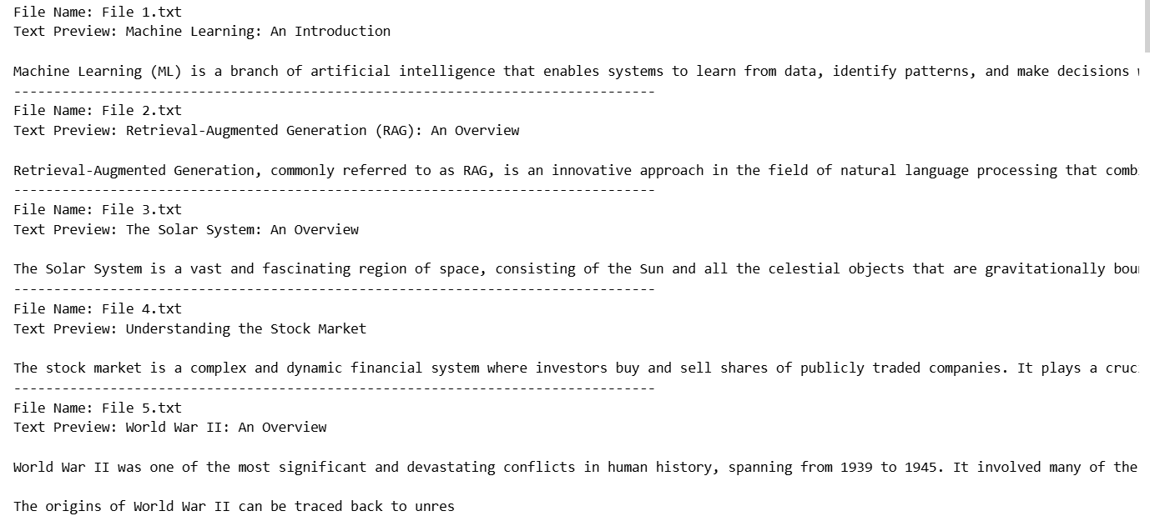
Step 1: Load Documents
Document Ingestion Process
All text files from the knowledge base folder are loaded into the system. Each file represents a document that can be referenced in response to user queries. This step ensures that all the source knowledge is available for further processing. Example files include File1.txt, File2.txt, and so on.

Slide 5
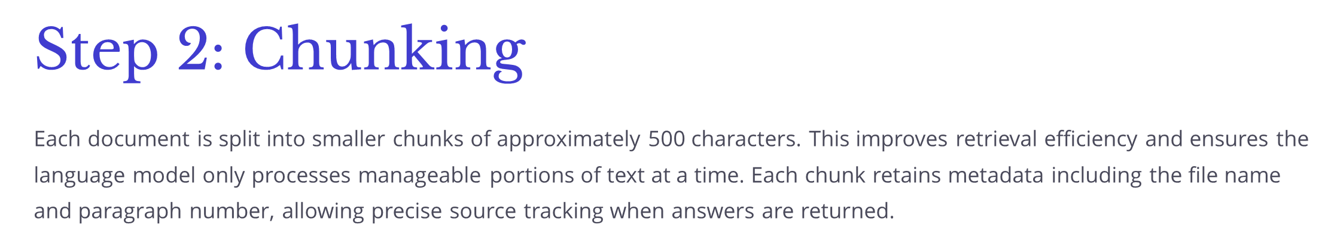
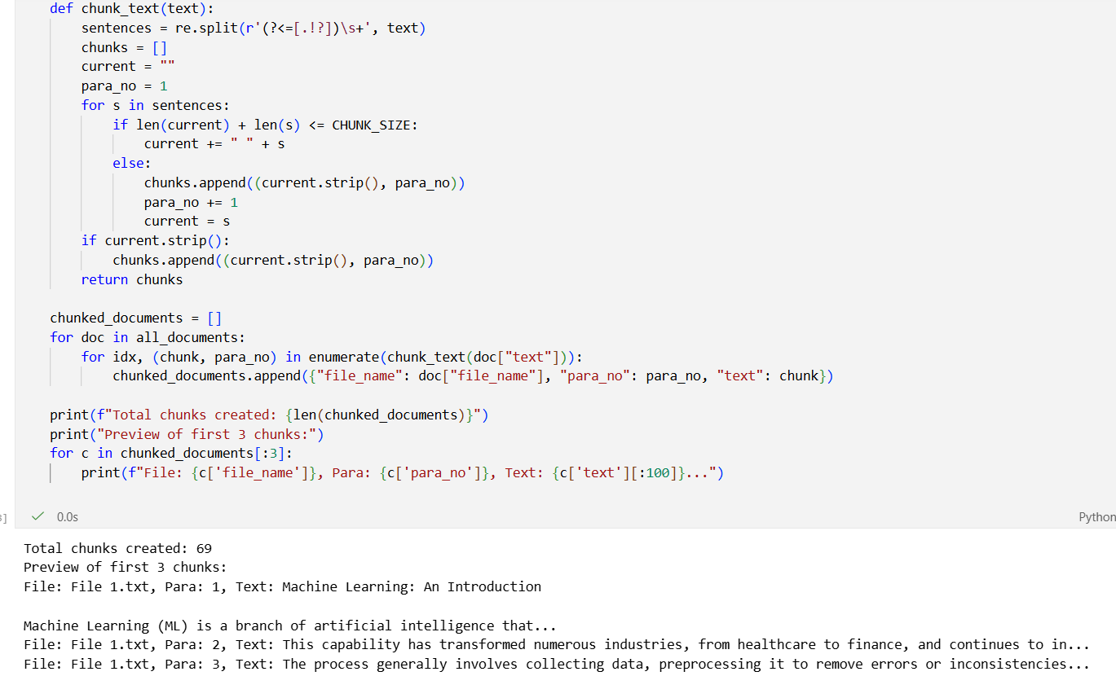

Slide 6
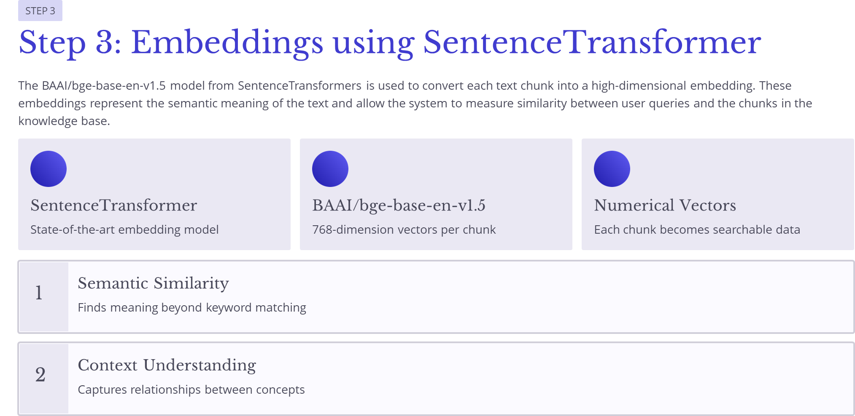

Slide 7
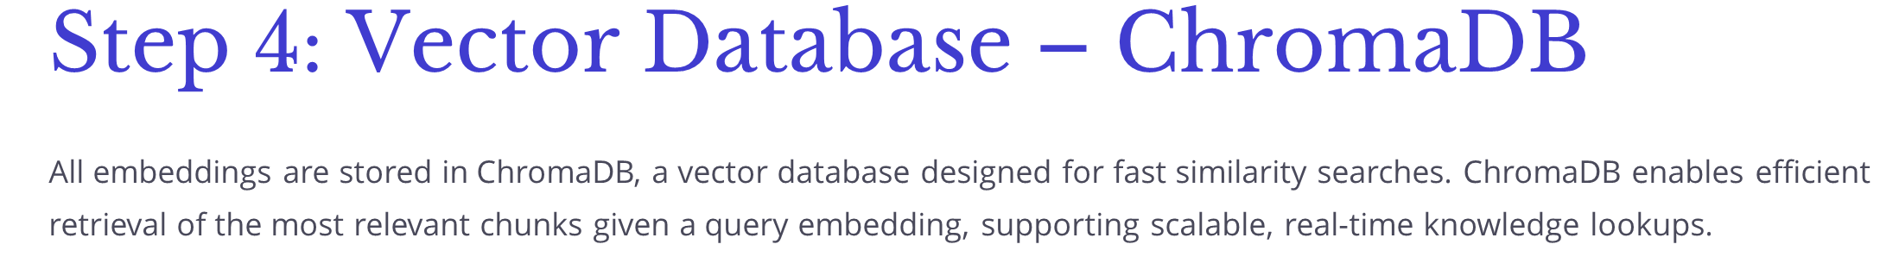
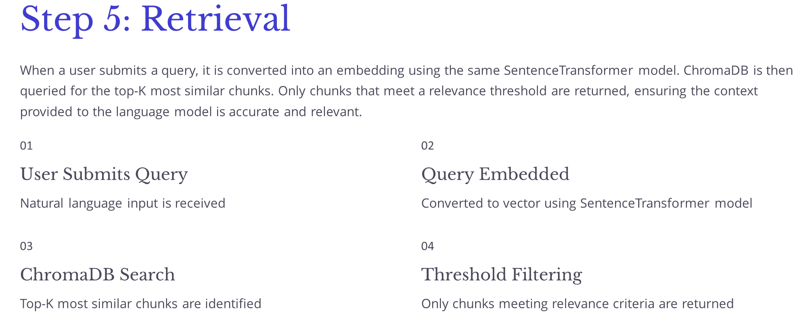

Slide 8
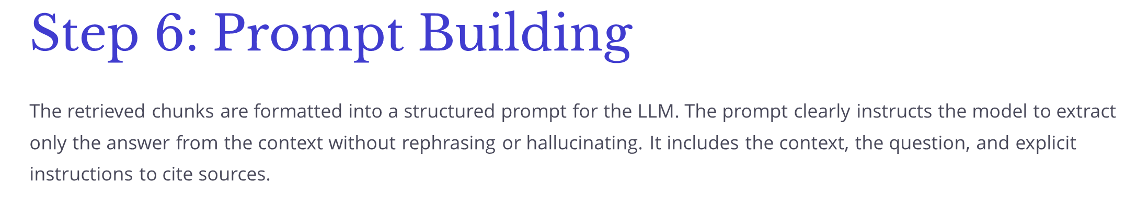
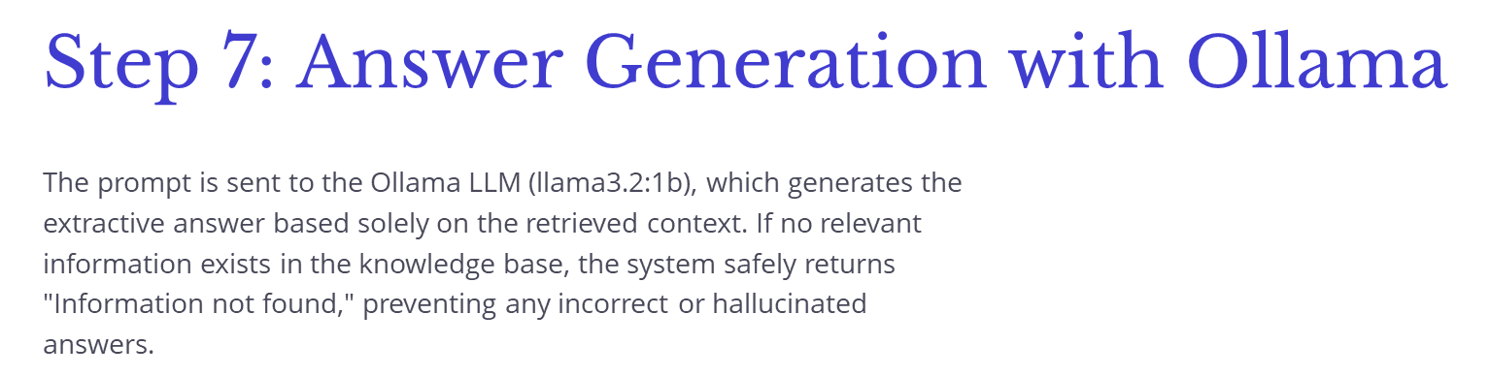

Slide 9
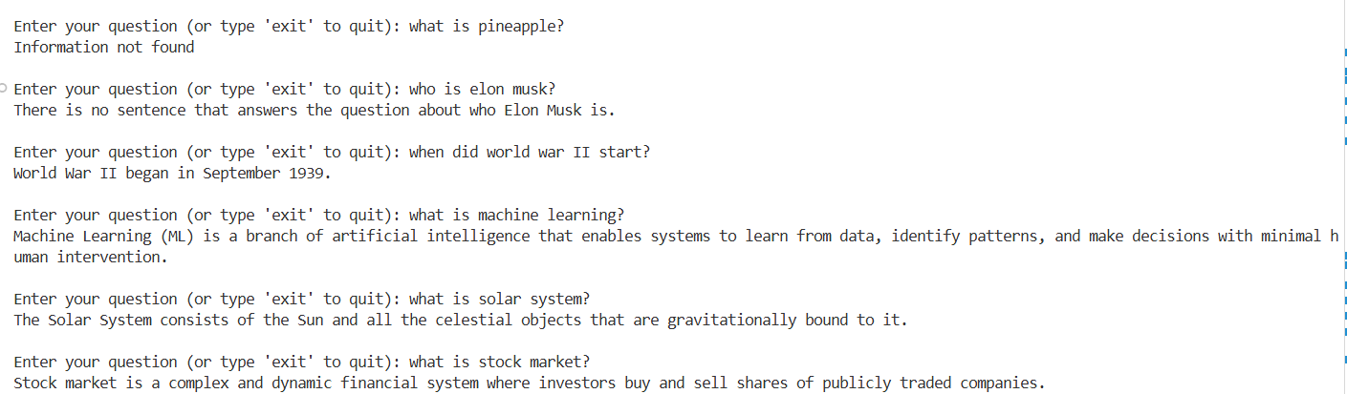
Results

